Slide 1
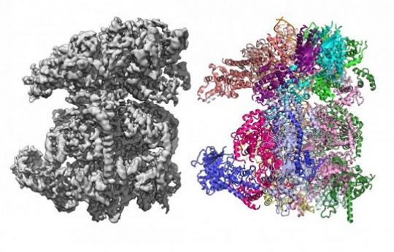
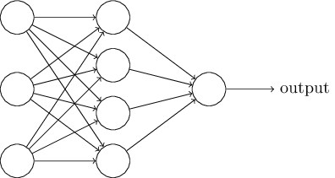
Deep Learning for Segmentation of 3D Cryo-EM Images
By: Devin Haslam
Jing He (Advisor)

Slide 2
Outline
Introduction
Previous Solutions
Data
Deep Learning
Methodology
Results and Discussion
Axis Comparison

Slide 3
Introduction

Slide 4
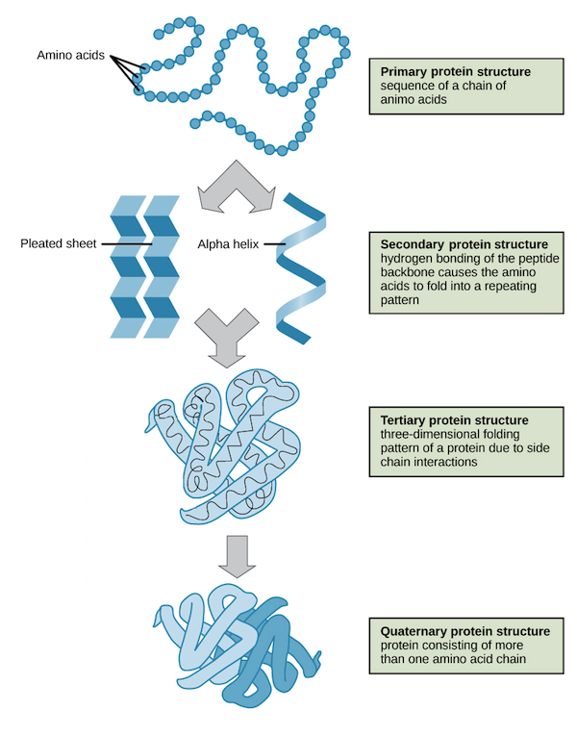
Proteins
Proteins are large, complex molecules that play many critical roles in the body
Required for the structure, function, and regulation of the body’s tissues and organs
https://courses.lumenlearning.com/suny-wmopen-biology1/chapter/proteins/

Slide 5
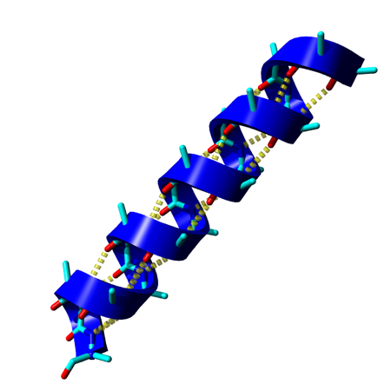
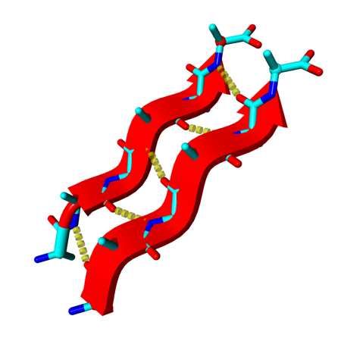
Secondary Structure Elements
Alpha Helix
Beta Sheet
http://curser.science.ru.nl/content-e/pub_NWI/Bioinformatics%20Summerschool%202006%20light%2003092006/documents/do_7457.htm

Slide 6
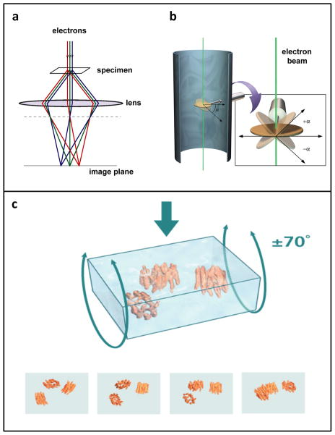
Cryo-EM
Electrons are beamed at specimen
Specimen is rotated in reference to electron beam
The collected images are computationally combined to get a 3D density image
https://www.quantamagazine.org/supercool-protein-imaging-gets-the-nobel-prize-20171004/

Slide 7
Cryo-EM Advantages
Cryo-EM eliminates the need to crystallize biomolecules
Cryo-EM can also visualize larger structures than NMR or crystallography can

Slide 8
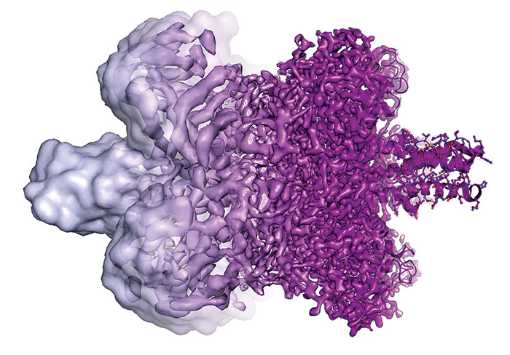
Nobel Prize
The 2017 Nobel Prize in Chemistry has been awarded to Jacques Dubochet, Joachim Frank, Richard Henderson for their development of cryo-EM
https://www.theguardian.com/science/2017/oct/04/what-is-cryo-electron-microscopy-the-chemistry-nobel-prize-winning-technique

Slide 9
The Problem
Many Cryo-EM images cannot be resolved to atomic resolution.
In medium resolution images, only secondary structures can be resolved.
Resolving secondary structures is an important step towards atomic resolution
Given a medium resolution map, we hope to model the secondary structures.

Slide 10
Reasons for solving proteins
The dynamic process of life maintenance, replication, defense and reproduction are carried out by proteins.
Why we have cancer, why we grow old, why we get sick, why life as we know it has evolved in this way and on this planet.

Slide 11
Previous Solutions

Slide 12
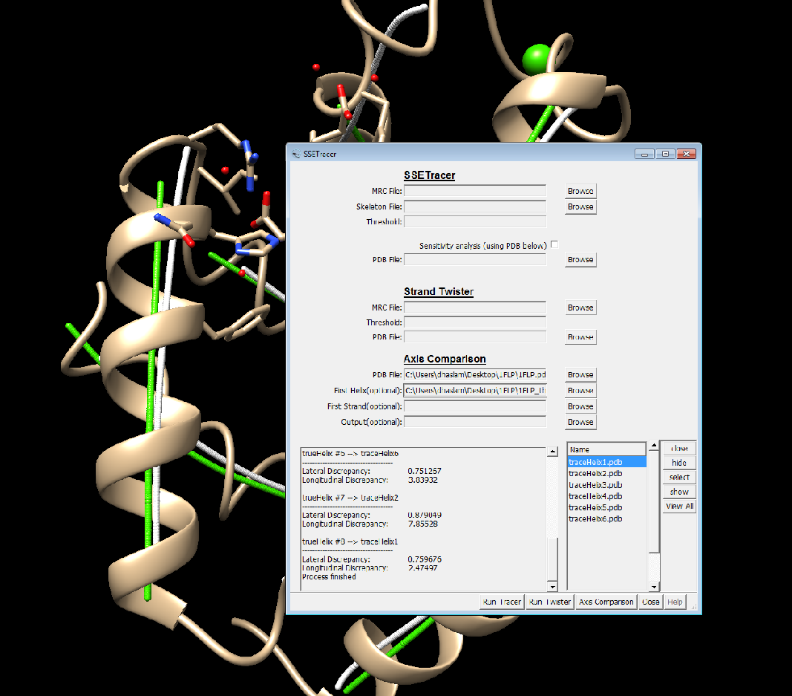
SSE Tracer
Disadvantages
Many parameters need tuning
Does not work for all proteins
Poor general accuracy
http://www.cs.odu.edu/~bioinfo/SSETracer/

Slide 13
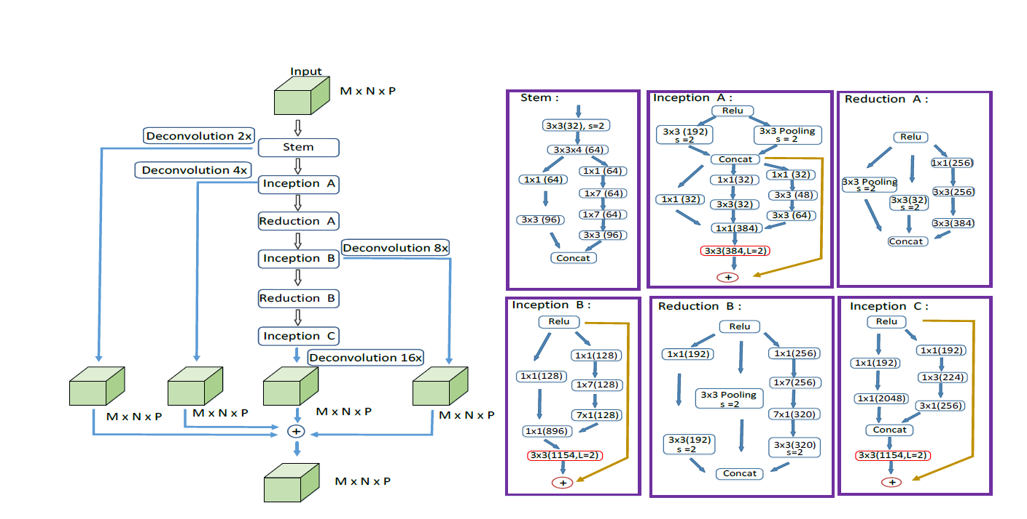
Previous Deep Learning Method
Disadvantages
Only simulated data
Not reproducible
Very complicated architecture

Slide 14
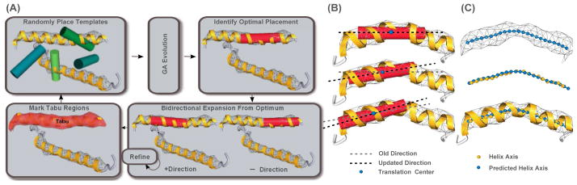
Voltrac
Disadvantages
Partially automatic
Only for helix detection
Slow
https://www.ncbi.nlm.nih.gov/pmc/articles/PMC3288247/figure/F1/

Slide 15
Data

Slide 16

Data used
Protein Data Bank
Simulated
Experimental
Medium Resolution (5-10 angstroms)
https://www.rcsb.org/

Slide 17
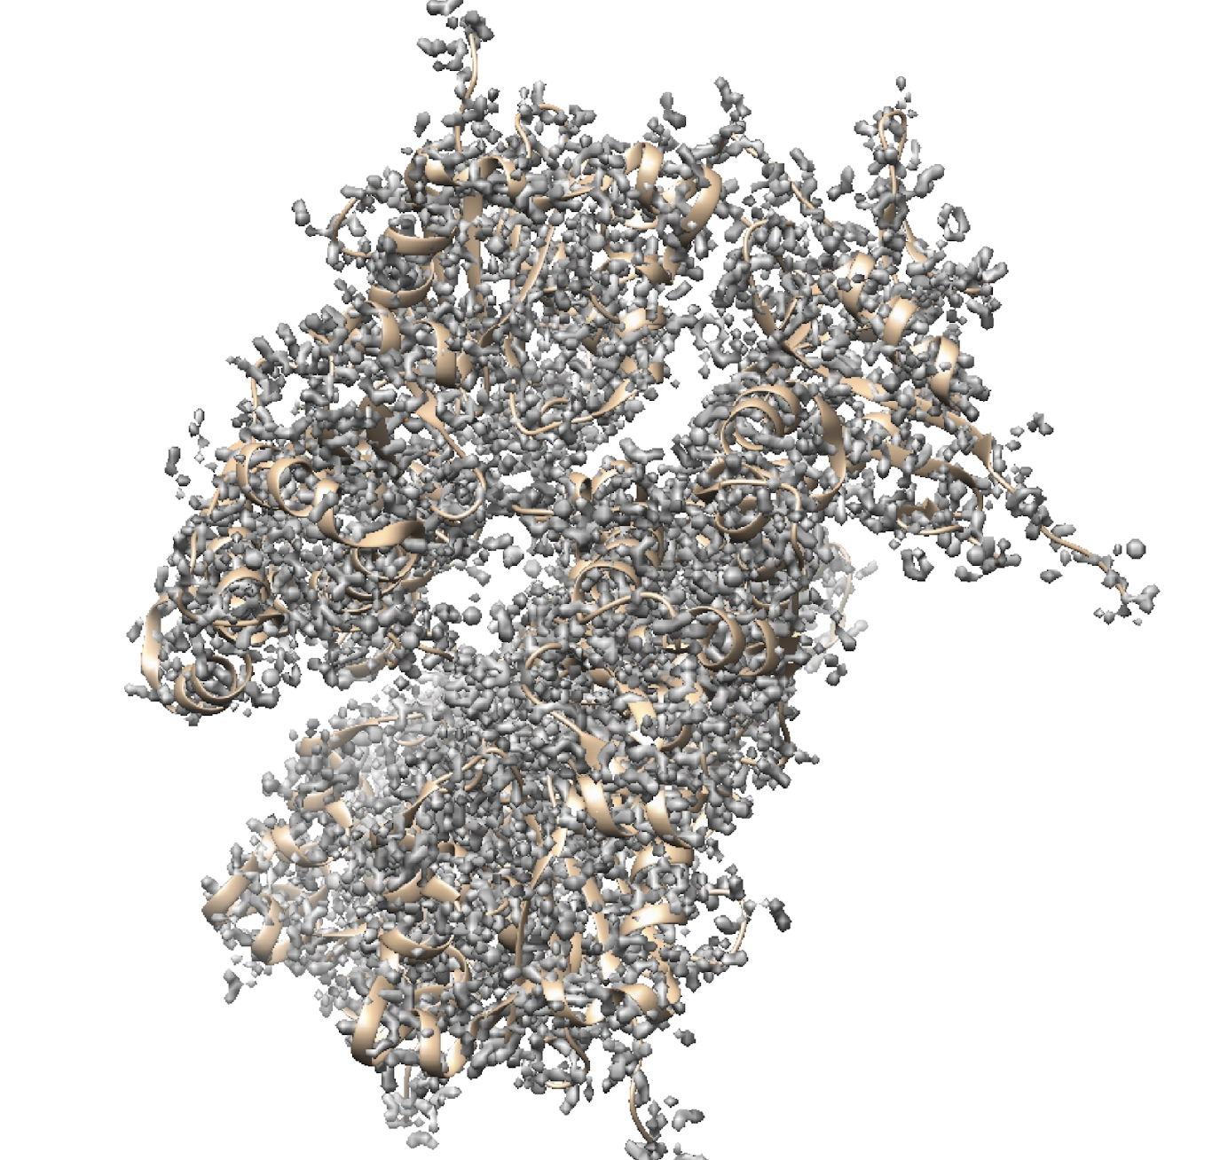
High Resolution
Simulated
2 angstroms

Slide 18
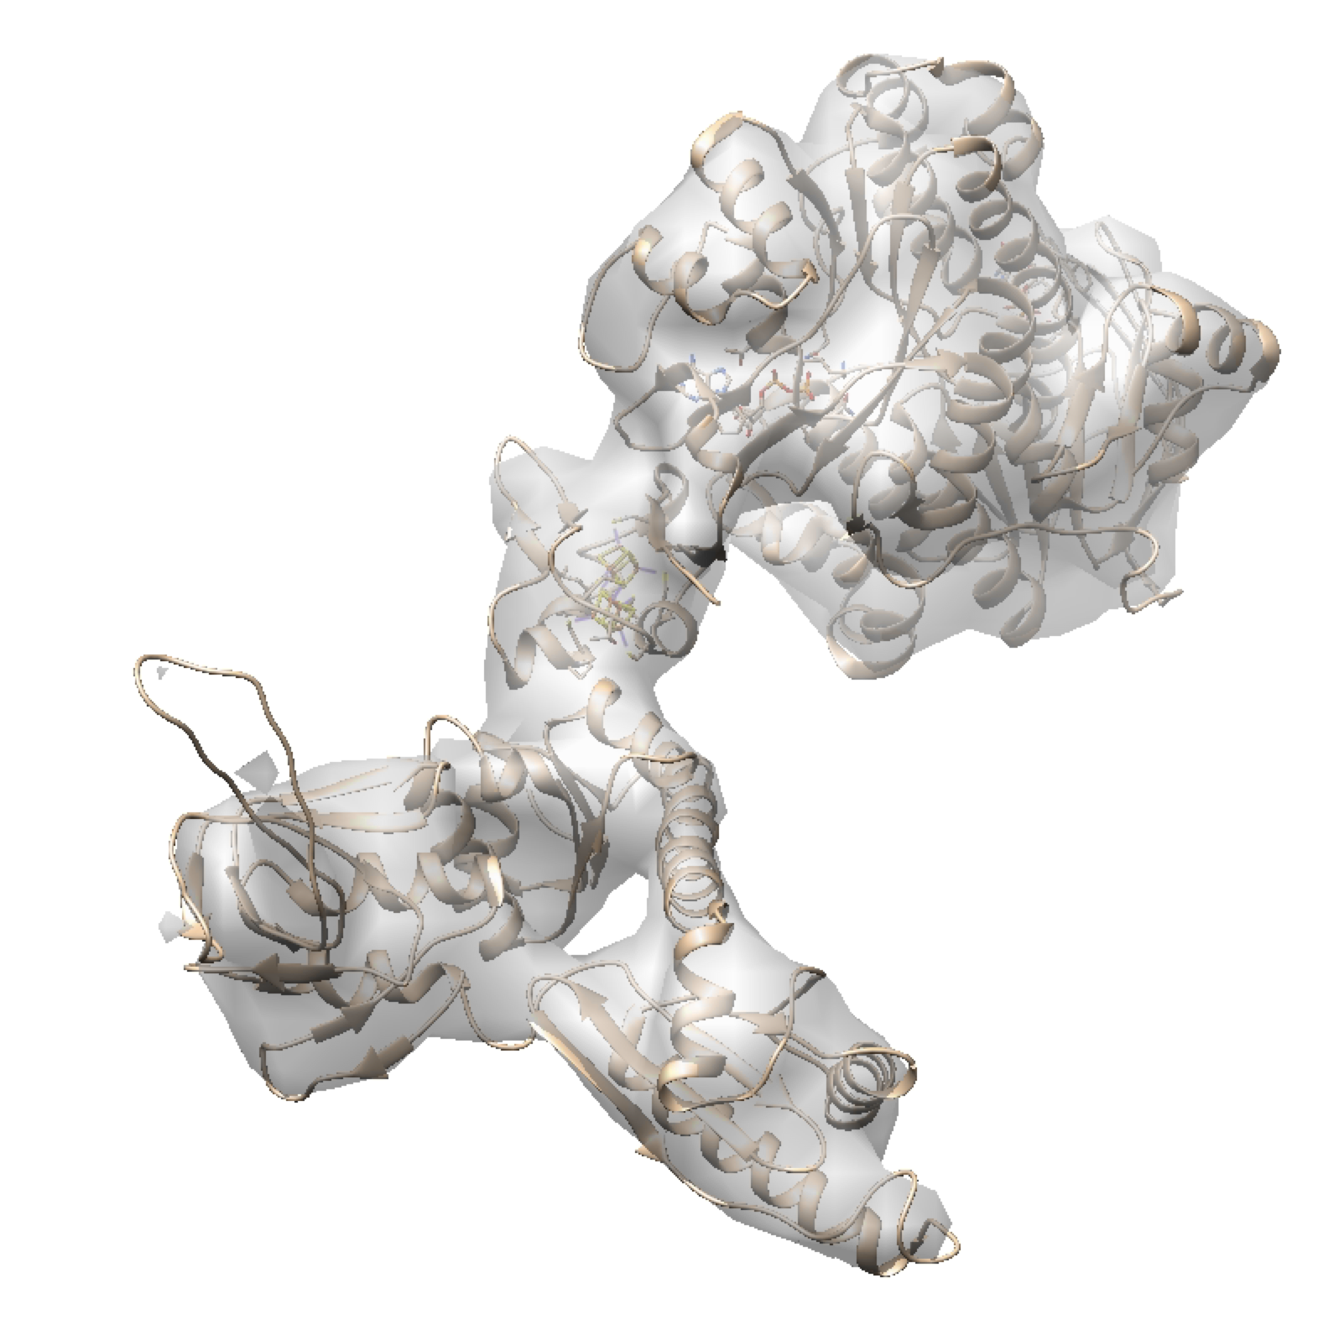
Low Resolution
Simulated
15 angstroms

Slide 19
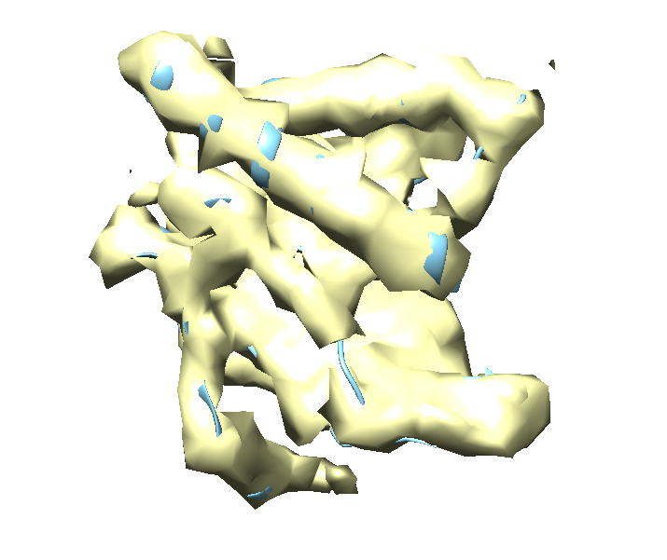
Medium Resolution
Simulated
8 angstroms
Helix
Beta Sheet

Slide 20
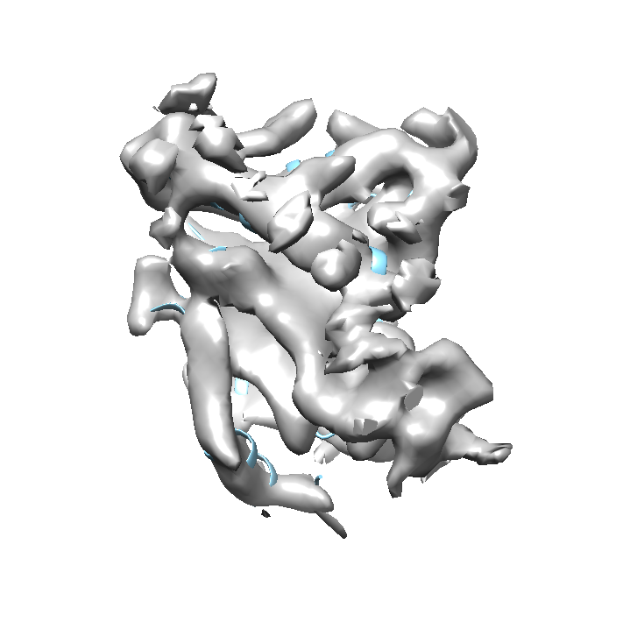
Medium Resolution
Experimental
6.8 angstroms
Helix
Beta Sheet

Slide 21
Challenges of the data
Large variety of chain sizes
Variety of resolution located within a single map
Lack of quantifications for determining a resolution
Diversity of each protein

Slide 22
Deep Learning

Slide 23
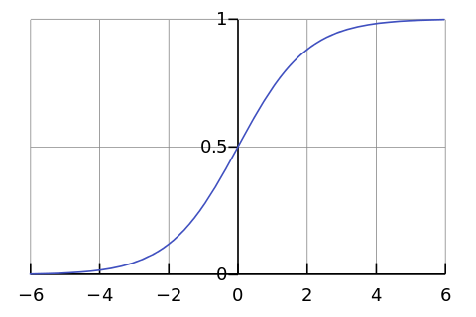
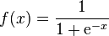
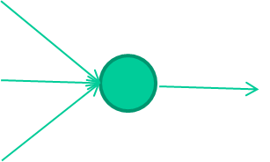
Neural Networks
-0.06
2.7
-8.6
f(x)
2.5
0.002
x = -0.06×2.7 + 2.5×8.6 + 1.4×0.002 = 21.34
1.4

Slide 24
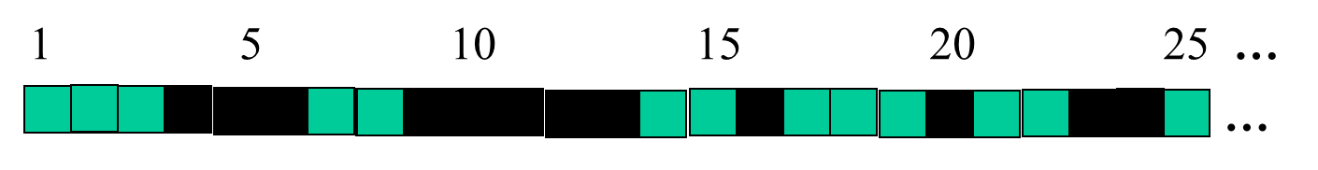
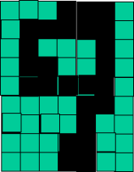
detect lines in
Specific positions
etc …
Higher level detetors
( horizontal line,
“RHS vertical lune”
“upper loop”, etc…
etc …
v
https://www.macs.hw.ac.uk/~dwcorne/Teaching/introdl.ppt

Slide 25

Convolution Example
https://stats.stackexchange.com/questions/199702/1d-convolution-in-neural-networks

Slide 26

Convolution Example
https://stats.stackexchange.com/questions/199702/1d-convolution-in-neural-networks

Slide 27
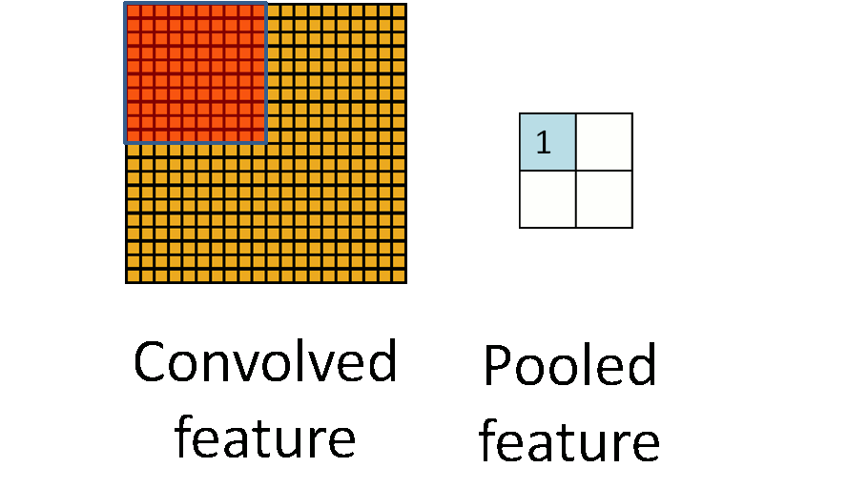
Pooling Example
http://ufldl.stanford.edu/wiki/index.php/Pooling
Notes:
Usually smaller receptive fields, can overlap some

Slide 28
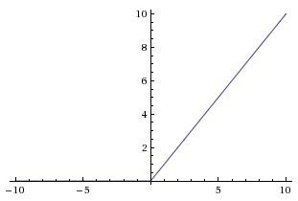
Relu
Popular activation function that prevents some neurons from firing
Less computationally expensive than other activation functions
https://en.wikipedia.org/wiki/Rectifier_(neural_networks)#/media/File:Rectifier_and_softplus_functions.svg

Slide 29
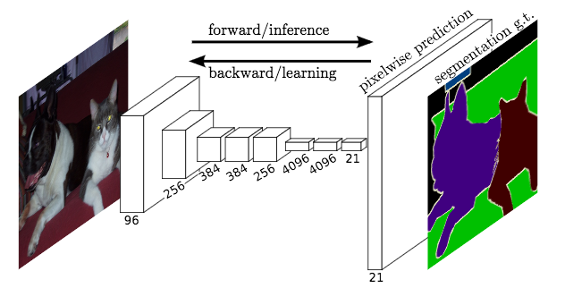
Fully Convolutional Neural Networks
https://medium.com/self-driving-cars/literature-review-fully-convolutional-networks-d0a11fe0a7aa

Slide 30
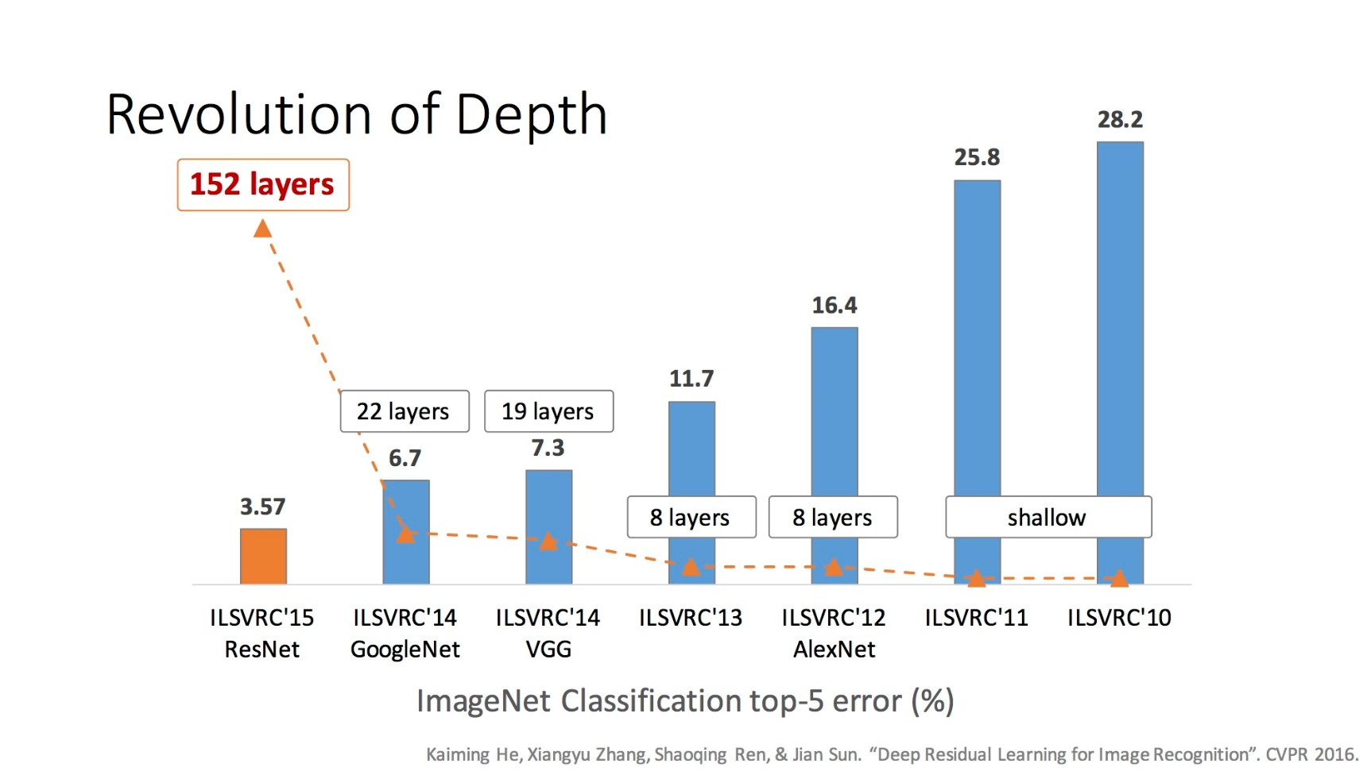
Increasing Depth
Notes:
2015 - Ensemble of Residual Networks
Reaching human levels of discrimination
2016 – down to 3.0% with ensemble, but not a new model (boring?) – No new major architectures, reaching Bayes limit, Interest waned and many main competitors had moved on

Slide 31
Methodology

Slide 32
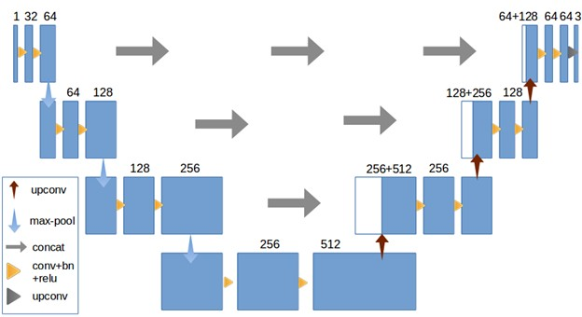
Our Network

Slide 33
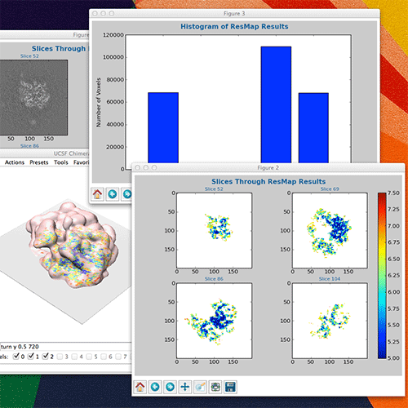
Initial Preparation of Data
Due to inaccurate resolution labels found in pdb, we visually prune the dataset
We hope to make this step automatic in the future using resmap
http://resmap.sourceforge.net/

Slide 34
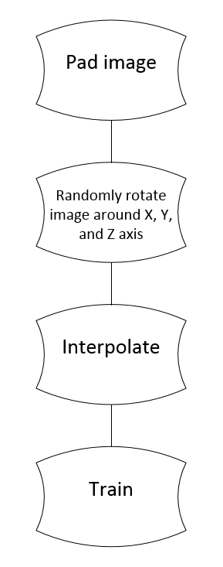
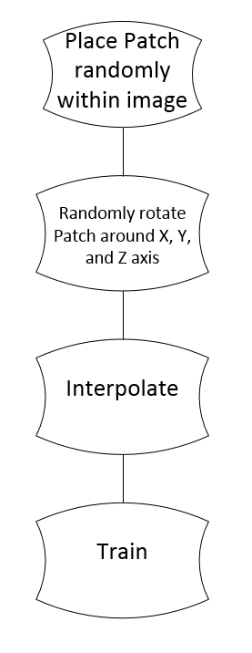
Full Image Training vs Patch Based Training
<1%
(48^3 and 32^3)
<1%
<1%
<1%
44%
47%
55%
52%
Average time per chain: 12.6s
Average time per chain: 7.4s

Slide 35
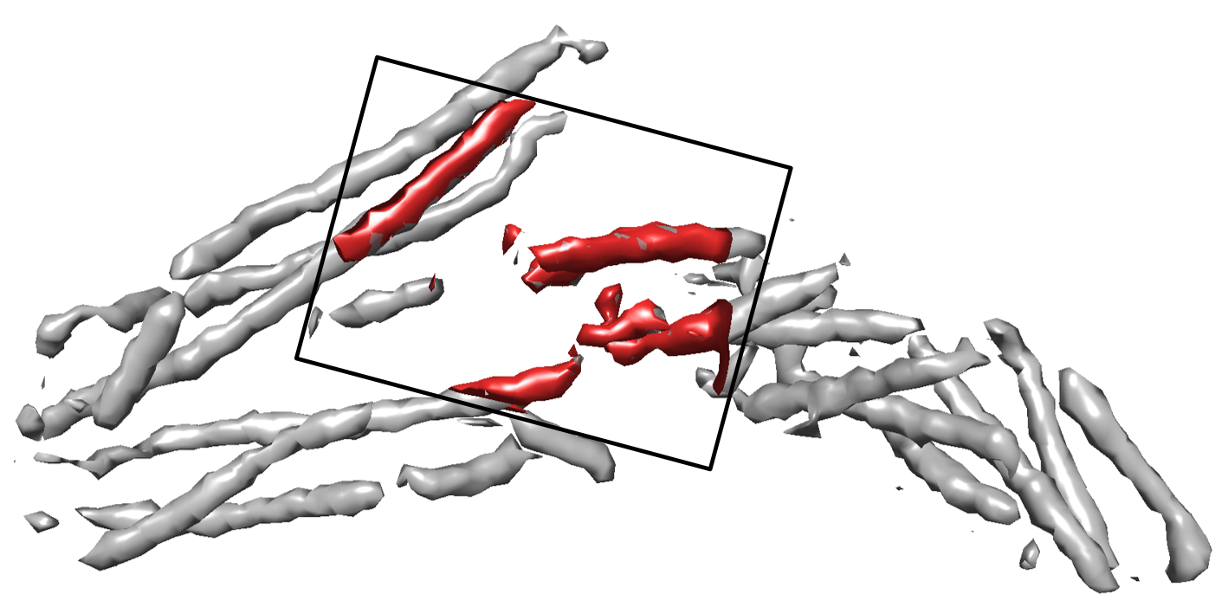
Data used – patch based

Slide 36
Current Parameters
1e-4 training rate
Adam optimizer
50% dropout rate
571 chains
125 proteins
Batch size 16 (Patch Based)
~50 epochs (Patch Based)
Batch size 1 (Full Image)
~25 epochs (Full Image)

Slide 37
Results and Discussion

Slide 38
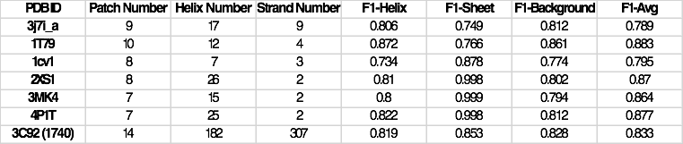
Simulated – Patch Based Training

Slide 39
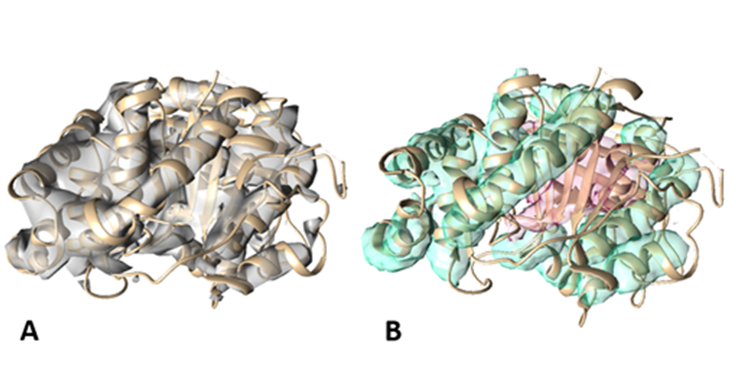
Simulated – Patch Based Training

Slide 40
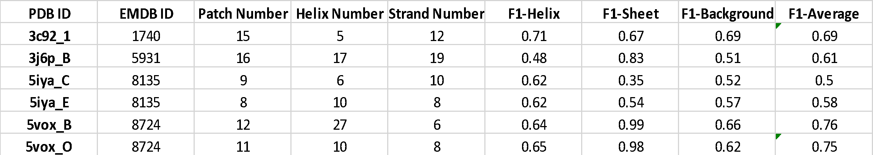
Experimental – Patch Based Training

Slide 41
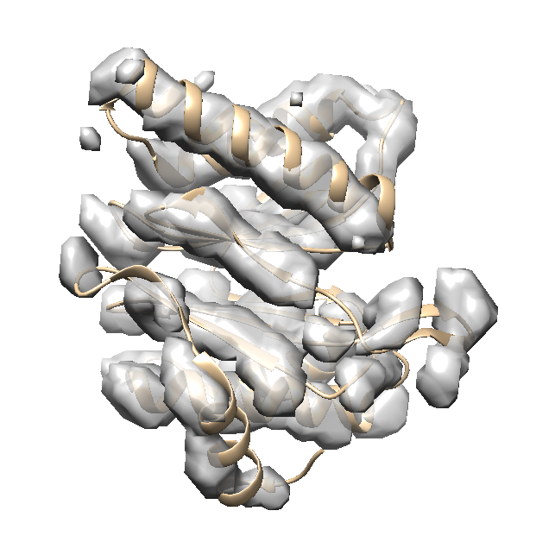
Experimental – Patch Based Training

Slide 42
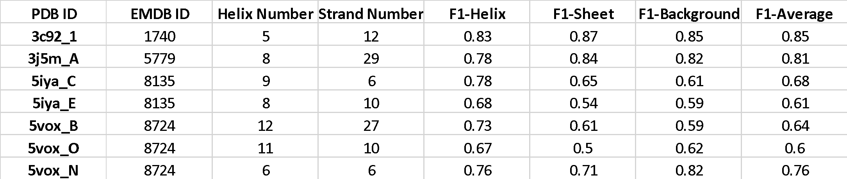
Experimental - Full Image Training

Slide 43
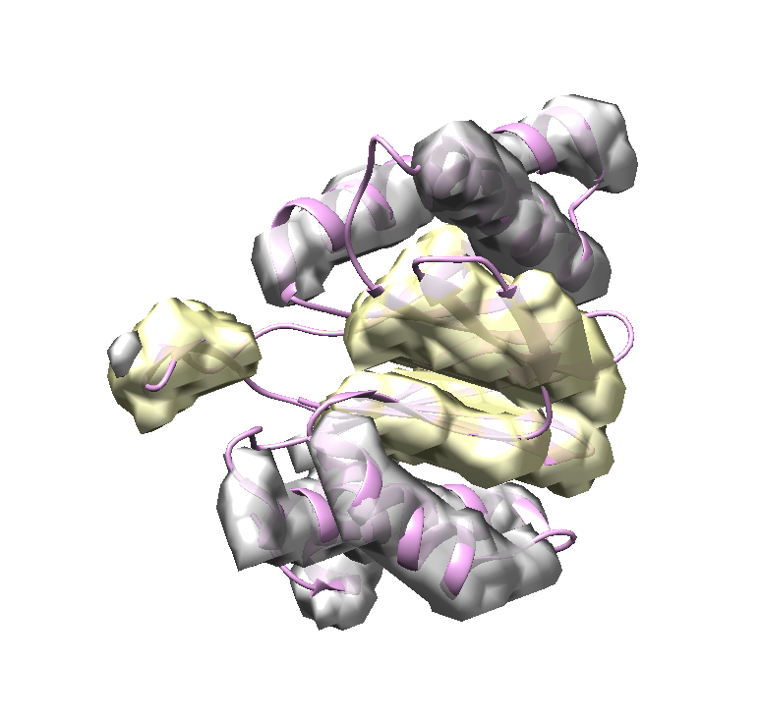
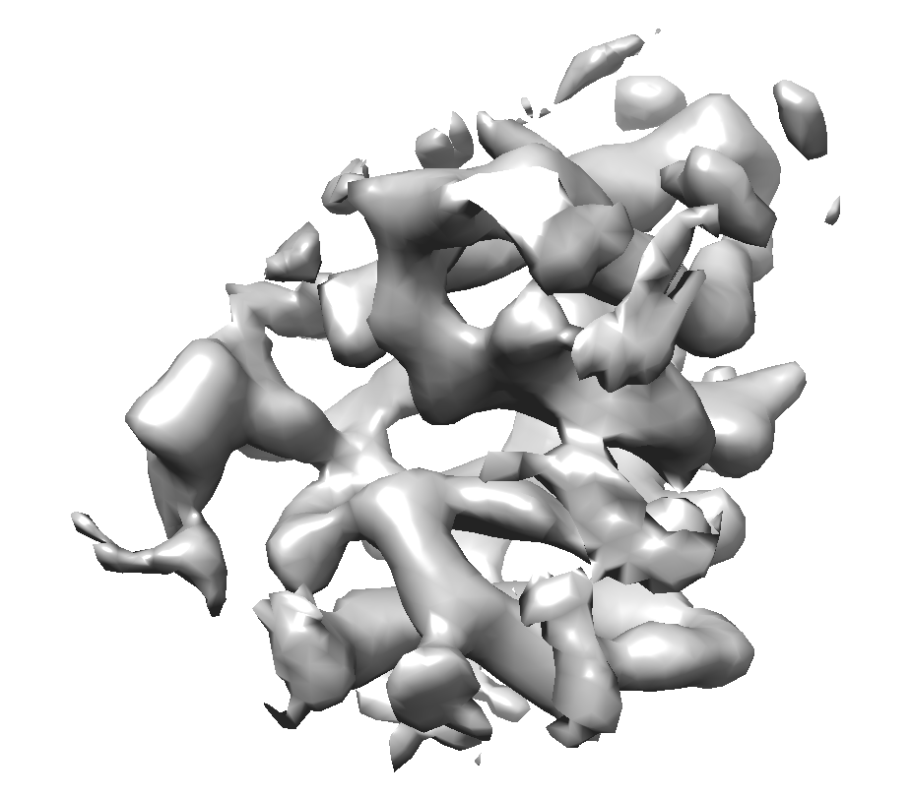
Experimental – Full Image Training

Slide 44
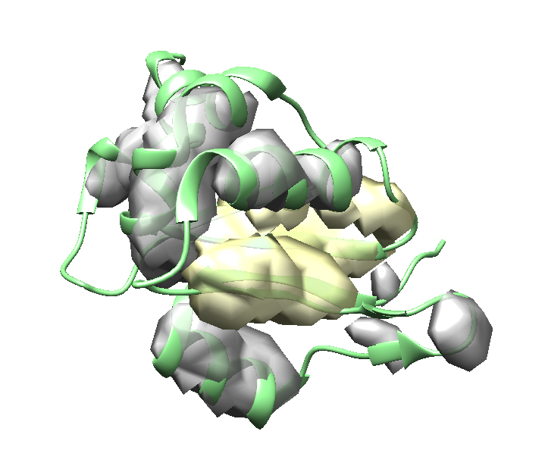
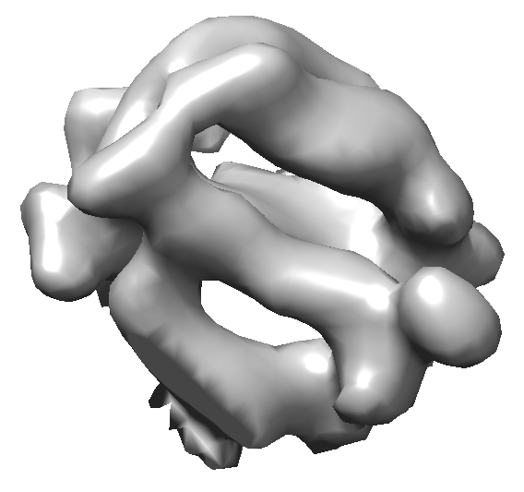
Experimental – Full Image Training

Slide 45
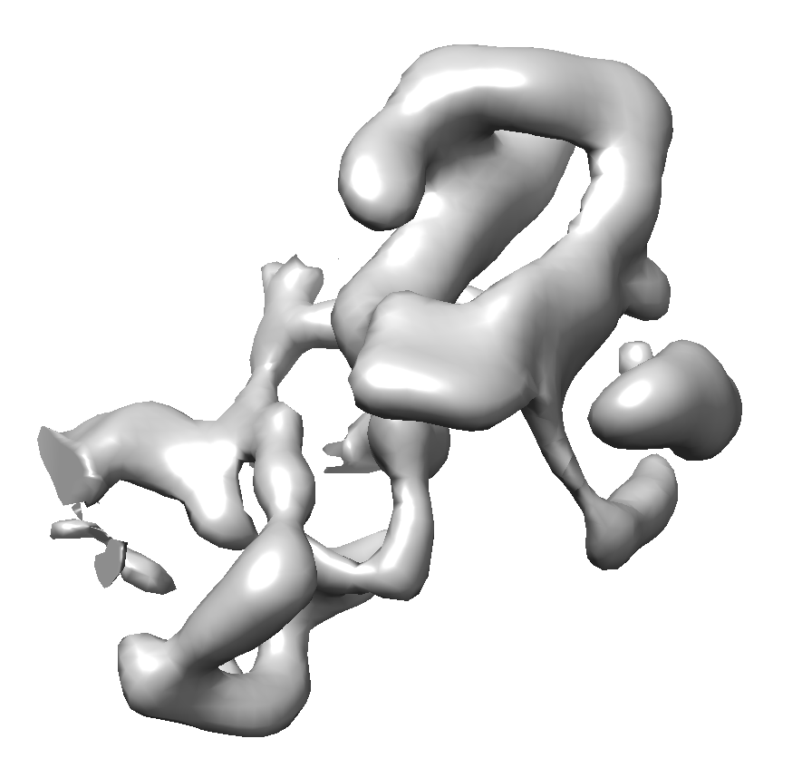
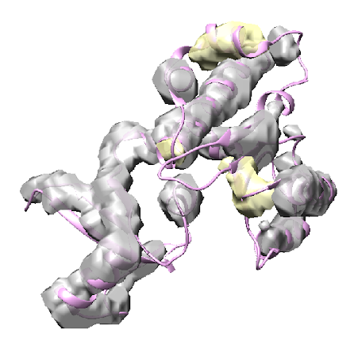
Experimental – Full Image Training

Slide 46
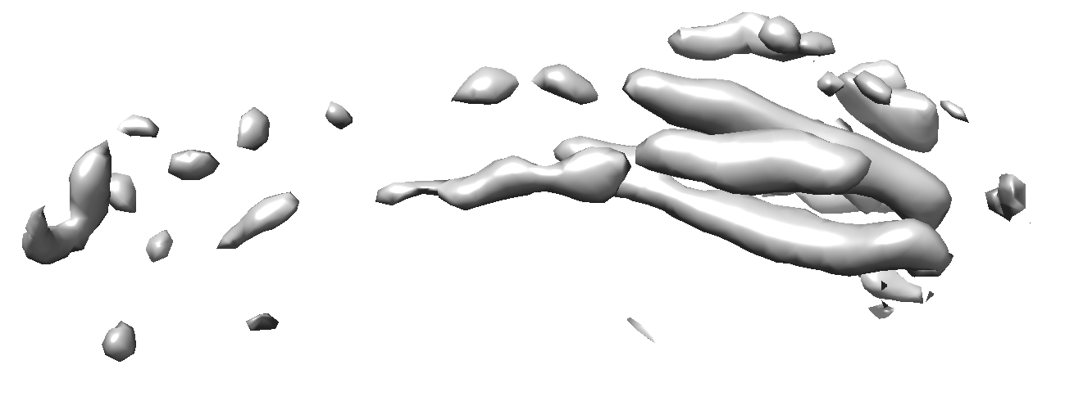
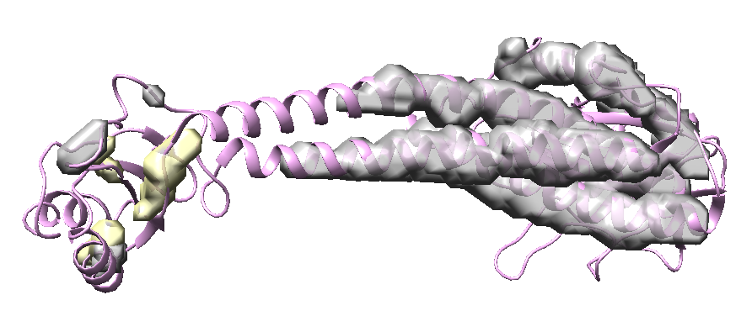
Experimental – Full Image Training

Slide 47
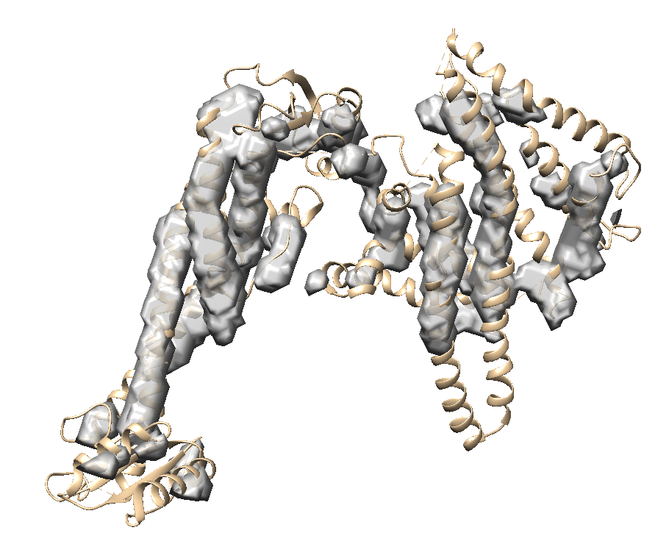
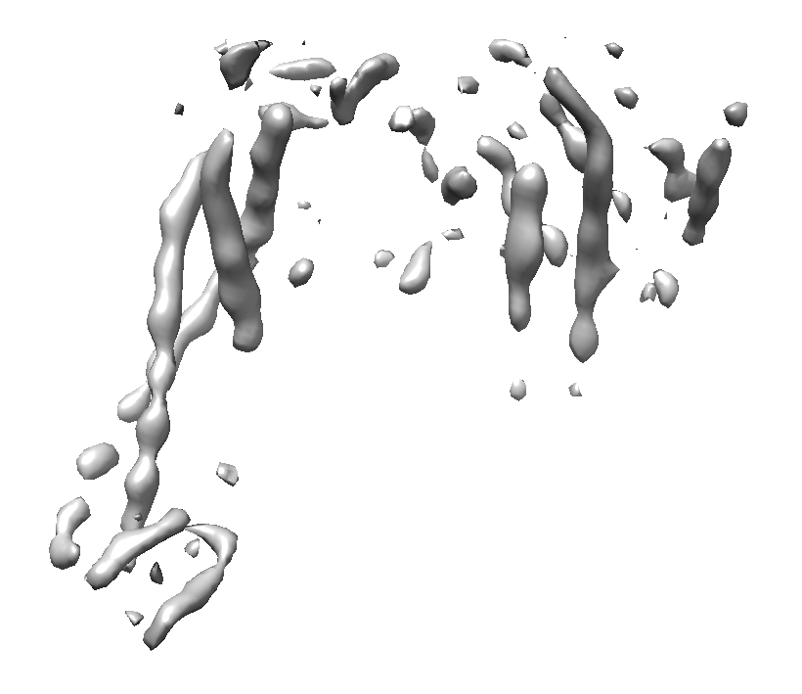
Experimental – Full Image Training

Slide 48
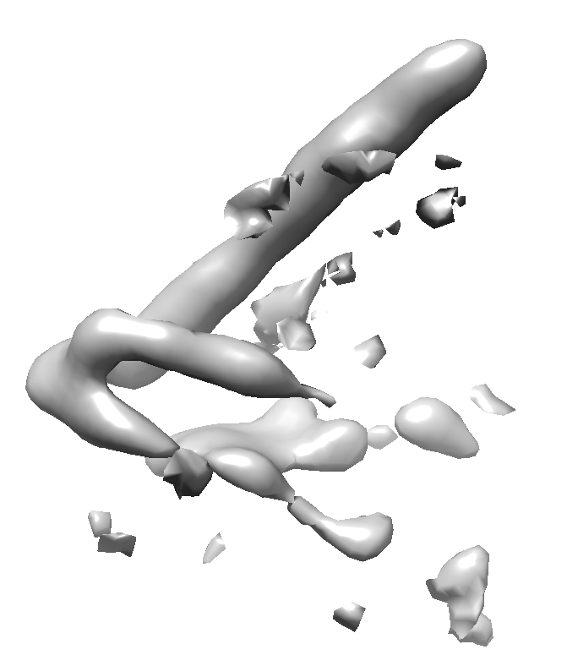
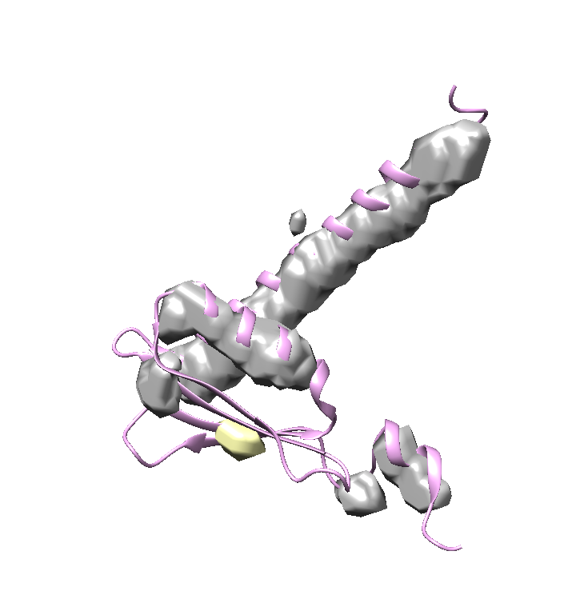
Experimental – Full Image Training

Slide 49
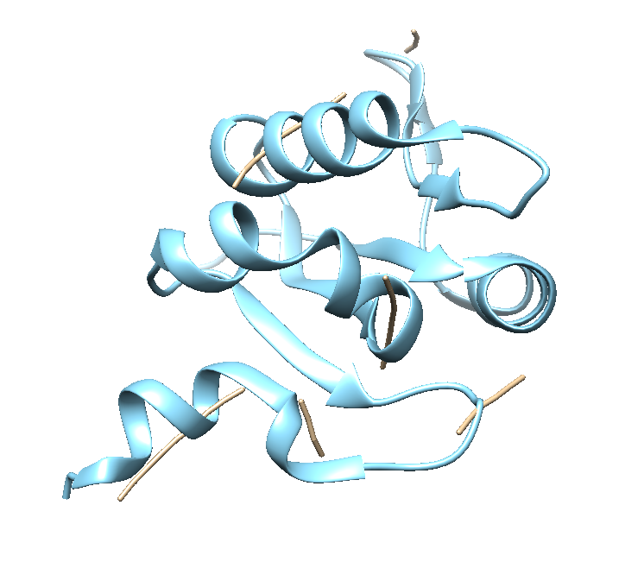
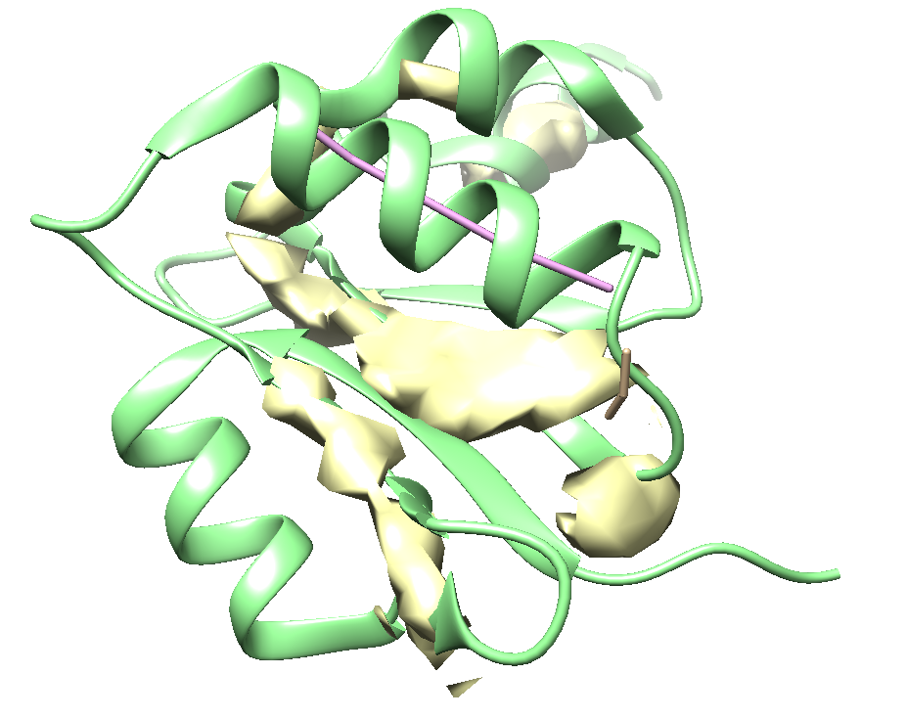
Method Comparisons
Our Method
SSETracer
Voltrac

Slide 50
Discussion
While patch based learning is very effective in a wide range of deep learning methods, it is not good in cases where geometry is skewed
Due to an unbalanced dataset, we seem to be more accurate with helices than beta sheets

Slide 51
Future Plans
Adjustment of hyper parameters
Size of image changes
Architecture changes
Incorporating resmap info
Adjust data
Post processing

Slide 52
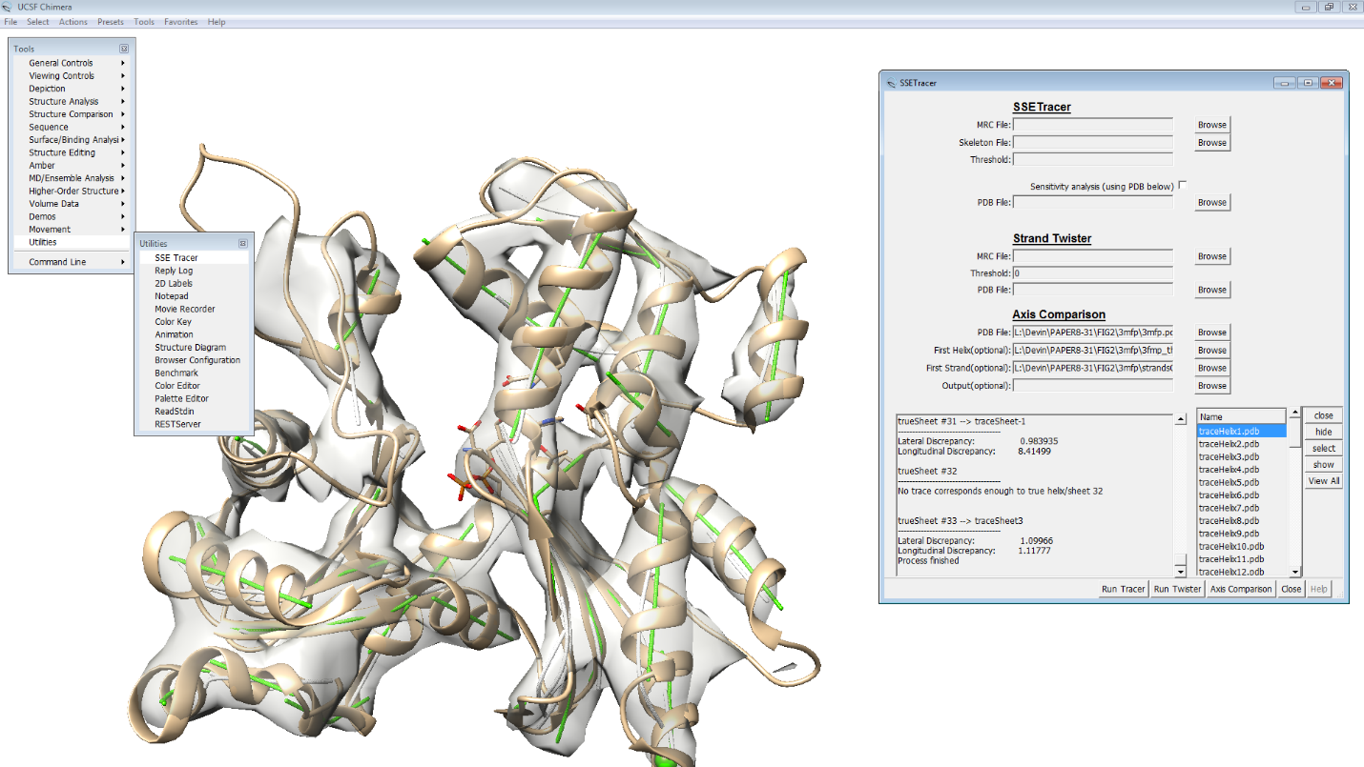
Axis Comparison

Slide 53
Publications
Devin Haslam, Salim Sazzed, Willy Wriggers, Julio Kovcas, Junha Song, Manfred Auer, Jing He: A Pattern Recognition Tool for Medium-Resolution Cryo-EM Density Maps and Low-Resolution Cryo-ET Density Maps. ISBRA 2018: 233-238
Devin Haslam, Mohammad Zubair, Desh Ranjan, Abhishek Biswas, Jing He: Challenges in matching secondary structures in cryo-EM: An exploration. BIBM 2016: 1714-1719
Devin Haslam, Tao Zeng, Rongjian Li, Jing He: Exploratory Studies Detecting Secondary Structures in Medium Resolution 3D Cryo-EM Images Using Deep Convolutional Neural Networks. CSBW 2018.

Slide 54
Thank You
Advisor – Dr. Jing He
Collaborators – Dr. Shuiwang Ji, Dr. Zeng Tao, Dr. Dong Si, Dr. Rongjian Li
Lab Collaborators– Salim Sazzad, Brittany Hasty, Michael Poteat, Tim Baker, Peter Scheible

Slide 55
Questions?

